Slide 1



Business_insights_360
View in Power BI
Last data refresh:
8/13/2025 7:07:09 AM UTC
Downloaded at:
8/14/2025 12:45:11 AM UTC

Slide 2
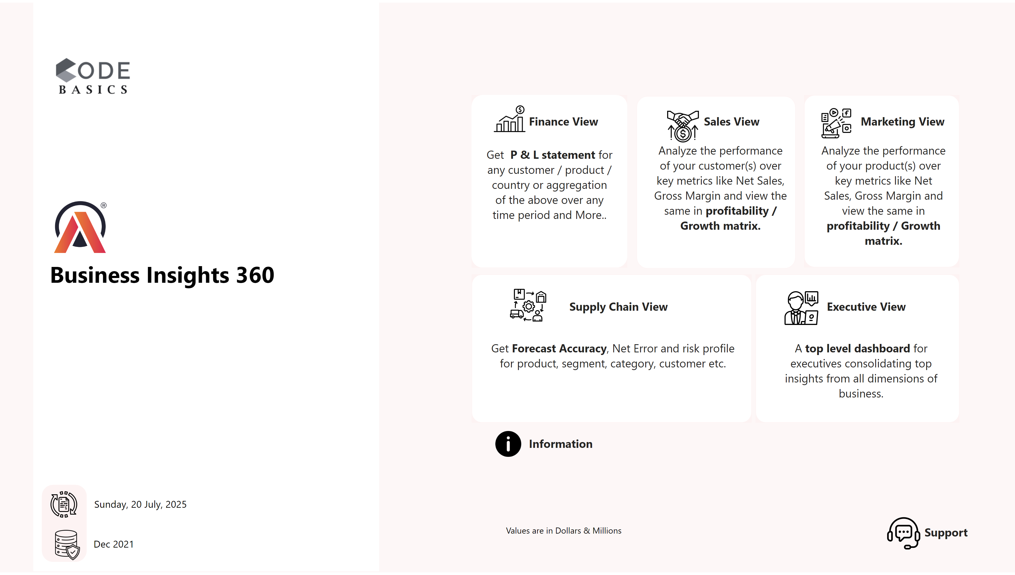
Home
Notes:
shape
No alt text provided
image
No alt text provided
image
No alt text provided
textbox
No alt text provided
shape
No alt text provided
card
No alt text provided
textbox
No alt text provided
shape
No alt text provided
shape
No alt text provided
shape
No alt text provided
shape
No alt text provided
shape
No alt text provided
textbox
No alt text provided
image
No alt text provided
image
No alt text provided
image
No alt text provided
image
No alt text provided
image
No alt text provided
textbox
No alt text provided
textbox
No alt text provided
textbox
No alt text provided
textbox
No alt text provided
textbox
No alt text provided
textbox
No alt text provided
textbox
No alt text provided
textbox
No alt text provided
textbox
No alt text provided
textbox
No alt text provided
textbox
No alt text provided
textbox
No alt text provided
image
No alt text provided
image
No alt text provided
image
No alt text provided
image
No alt text provided
actionButton
No alt text provided
textbox
No alt text provided
shape
No alt text provided
textbox
No alt text provided
shape
No alt text provided
shape
No alt text provided
shape
No alt text provided
actionButton
No alt text provided
shape
No alt text provided
shape
No alt text provided
shape
No alt text provided
shape
No alt text provided
shape
No alt text provided
textbox
No alt text provided
shape
No alt text provided
shape
No alt text provided

Slide 3
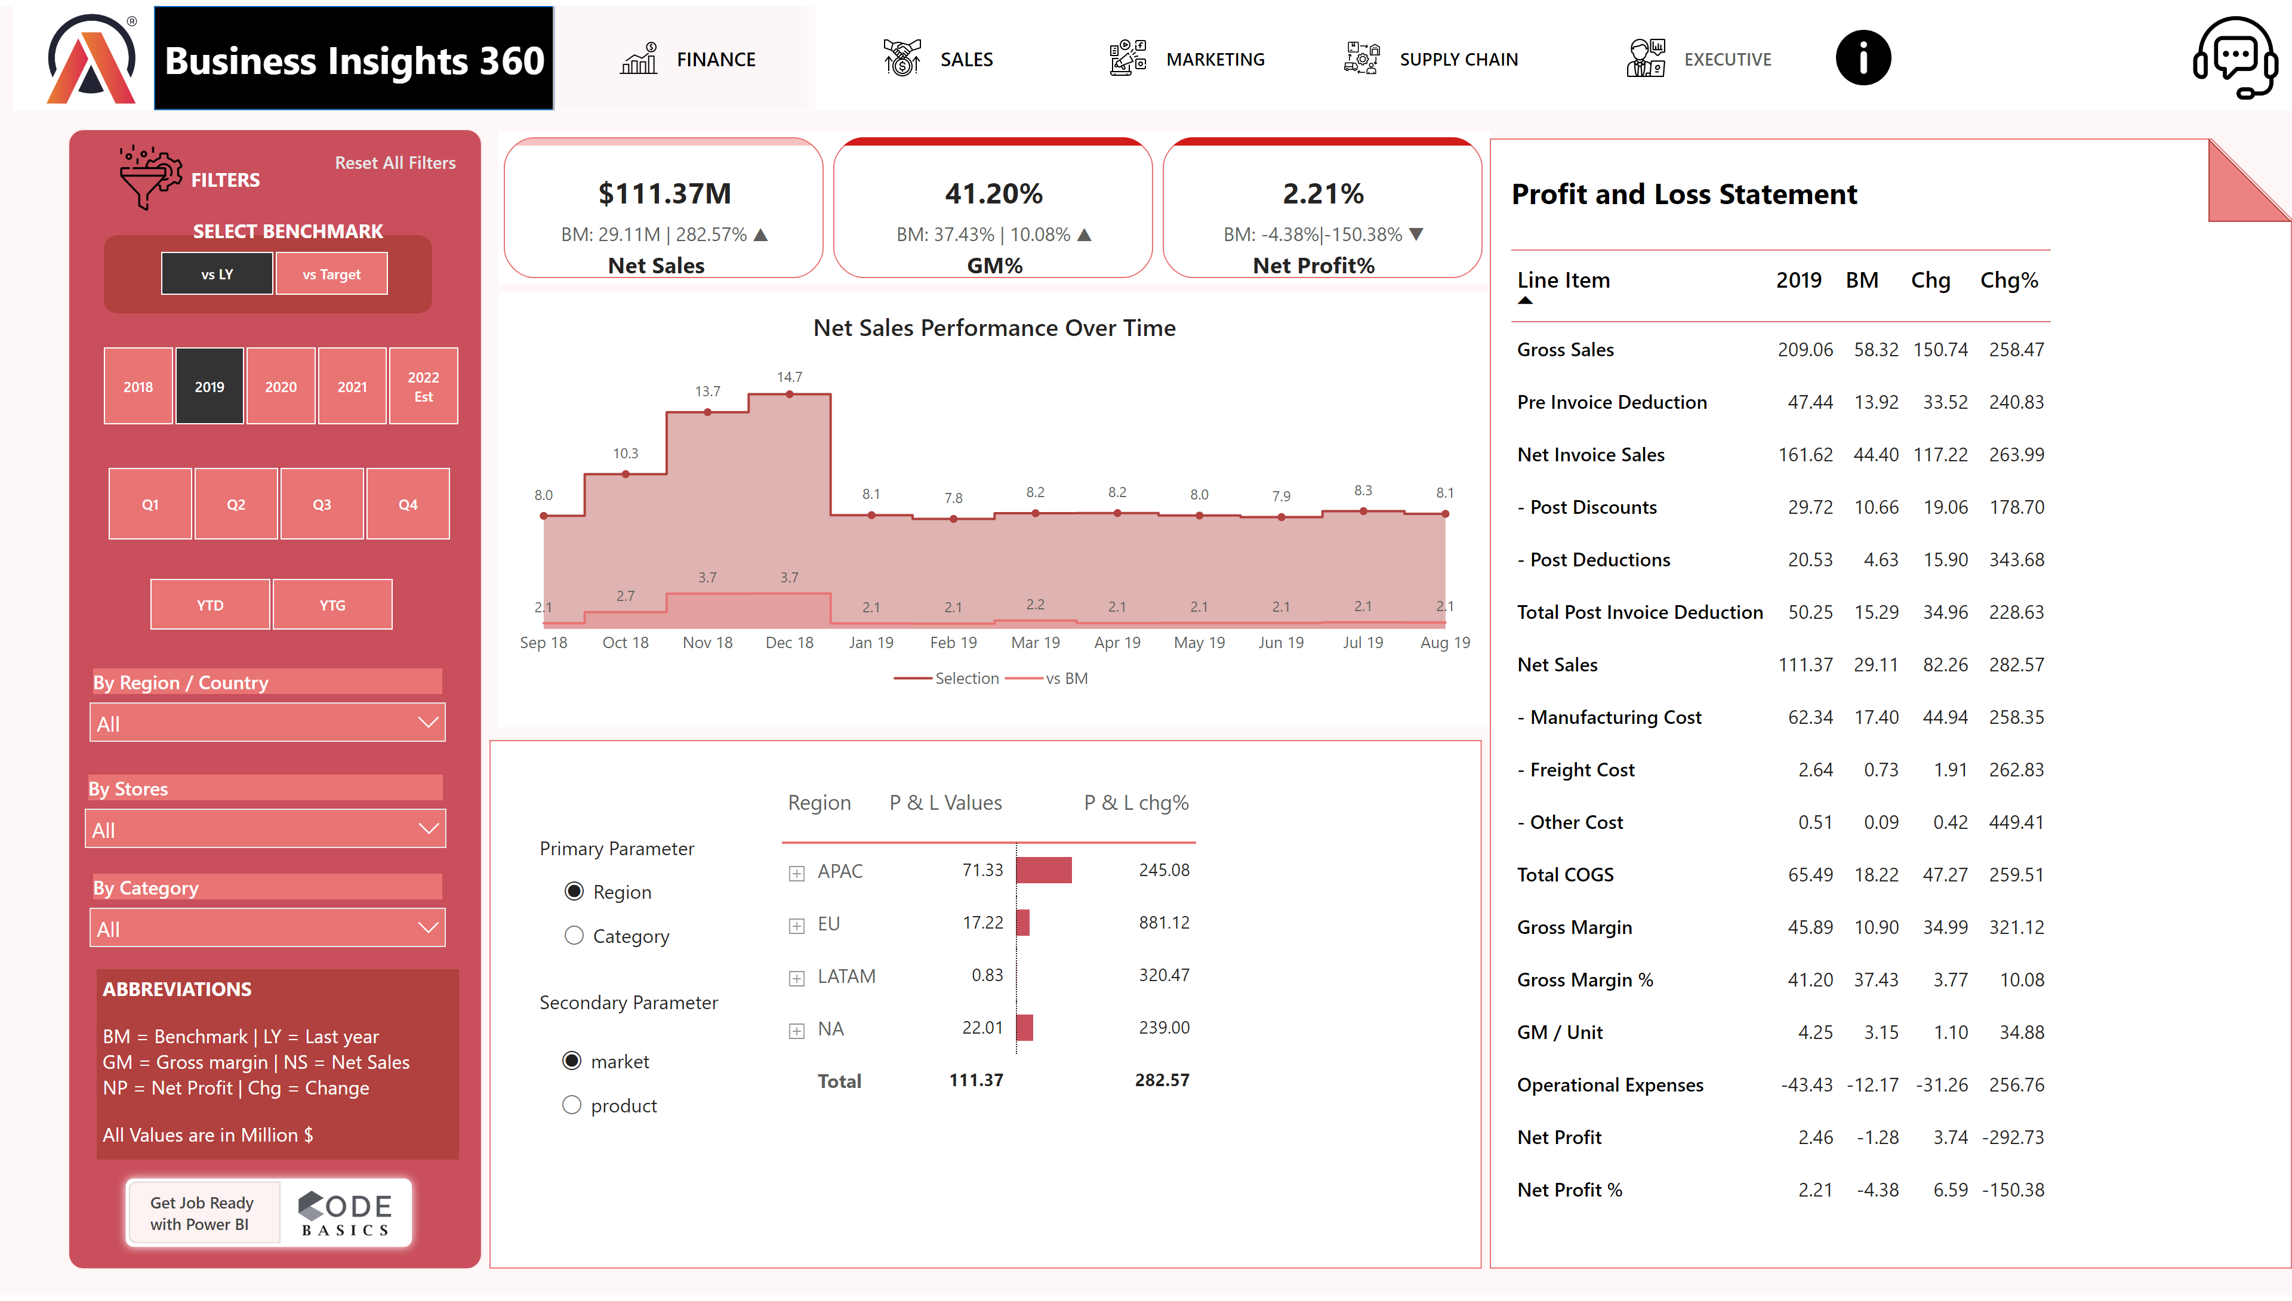
Finance View
Notes:
shape
No alt text provided
image
No alt text provided
shape
No alt text provided
actionButton
No alt text provided
actionButton
No alt text provided
actionButton
No alt text provided
actionButton
No alt text provided
actionButton
No alt text provided
image
No alt text provided
image
No alt text provided
shape
No alt text provided
image
No alt text provided
textbox
No alt text provided
slicer
No alt text provided
textbox
No alt text provided
slicer
No alt text provided
slicer
No alt text provided
slicer
No alt text provided
slicer
No alt text provided
slicer
No alt text provided
slicer
No alt text provided
shape
No alt text provided
image
No alt text provided
shape
No alt text provided
textbox
No alt text provided
cardVisual
No alt text provided
shape
No alt text provided
actionButton
No alt text provided
textbox
No alt text provided
textbox
No alt text provided
textbox
No alt text provided
Net Sales Performance Over Time
No alt text provided
shape
No alt text provided
card
No alt text provided
shape
No alt text provided
shape
No alt text provided
textbox
No alt text provided
pivotTable
No alt text provided
shape
No alt text provided
slicer
No alt text provided
slicer
No alt text provided
pivotTable
No alt text provided
textbox
No alt text provided
textbox
No alt text provided
actionButton
No alt text provided
textbox
No alt text provided
shape
No alt text provided
textbox
No alt text provided
shape
No alt text provided
shape
No alt text provided
shape
No alt text provided
actionButton
No alt text provided
shape
No alt text provided
shape
No alt text provided
shape
No alt text provided
shape
No alt text provided
shape
No alt text provided
textbox
No alt text provided
shape
No alt text provided
shape
No alt text provided

Slide 4
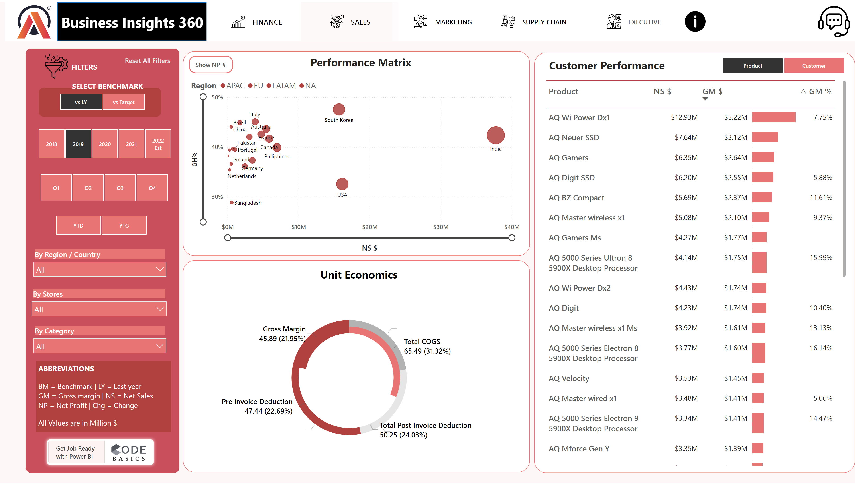
Sales View
Notes:
shape
No alt text provided
image
No alt text provided
shape
No alt text provided
actionButton
No alt text provided
actionButton
No alt text provided
actionButton
No alt text provided
actionButton
No alt text provided
actionButton
No alt text provided
image
No alt text provided
image
No alt text provided
shape
No alt text provided
image
No alt text provided
textbox
No alt text provided
slicer
No alt text provided
textbox
No alt text provided
slicer
No alt text provided
slicer
No alt text provided
slicer
No alt text provided
slicer
No alt text provided
slicer
No alt text provided
slicer
No alt text provided
shape
No alt text provided
image
No alt text provided
shape
No alt text provided
textbox
No alt text provided
shape
No alt text provided
actionButton
No alt text provided
shape
No alt text provided
textbox
No alt text provided
NP % Button
No alt text provided
GM % Visual
No alt text provided
actionButton
No alt text provided
scatterChart
No alt text provided
pivotTable
No alt text provided
slicer
No alt text provided
textbox
No alt text provided
shape
No alt text provided
shape
No alt text provided
donutChart
No alt text provided
donutChart
No alt text provided
textbox
No alt text provided
actionButton
No alt text provided
textbox
No alt text provided
shape
No alt text provided
textbox
No alt text provided
shape
No alt text provided
shape
No alt text provided
shape
No alt text provided
actionButton
No alt text provided
shape
No alt text provided
shape
No alt text provided
shape
No alt text provided
shape
No alt text provided
shape
No alt text provided
textbox
No alt text provided
shape
No alt text provided
shape
No alt text provided

Slide 5
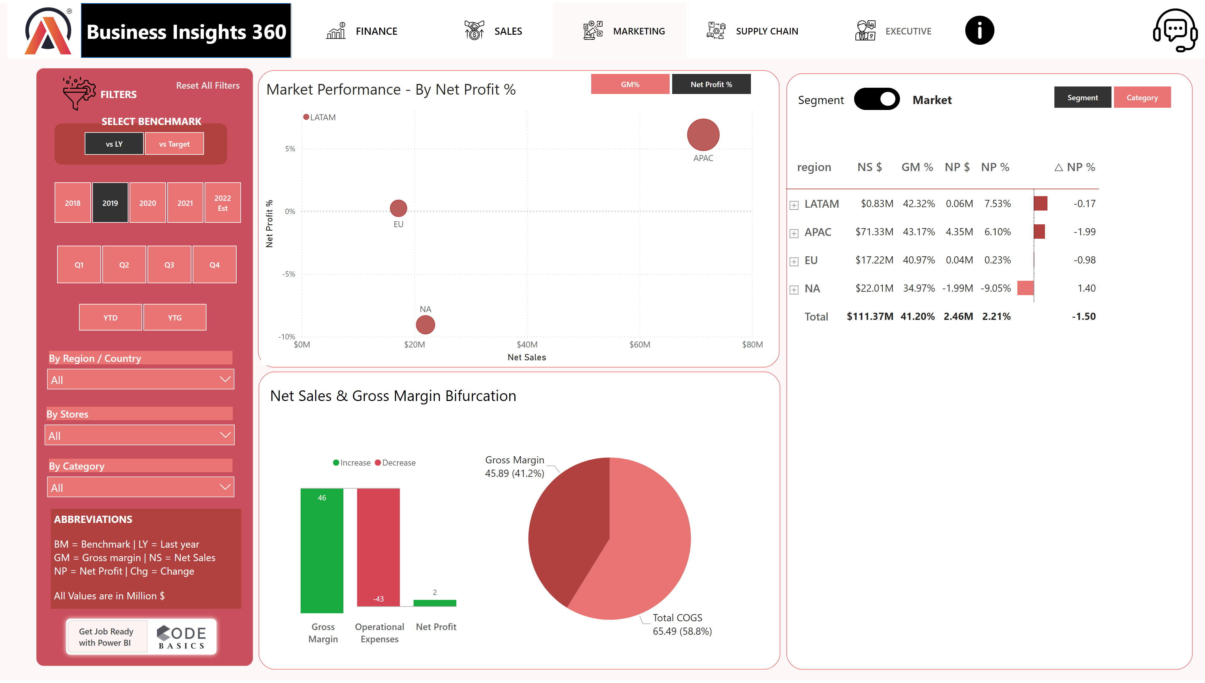
Marketing View
Notes:
shape
No alt text provided
image
No alt text provided
shape
No alt text provided
actionButton
No alt text provided
actionButton
No alt text provided
actionButton
No alt text provided
actionButton
No alt text provided
actionButton
No alt text provided
image
No alt text provided
image
No alt text provided
shape
No alt text provided
image
No alt text provided
textbox
No alt text provided
slicer
No alt text provided
textbox
No alt text provided
slicer
No alt text provided
slicer
No alt text provided
slicer
No alt text provided
slicer
No alt text provided
slicer
No alt text provided
slicer
No alt text provided
shape
No alt text provided
image
No alt text provided
shape
No alt text provided
textbox
No alt text provided
shape
No alt text provided
actionButton
No alt text provided
textbox
No alt text provided
shape
No alt text provided
image
No alt text provided
textbox
No alt text provided
textbox
No alt text provided
shape
No alt text provided
shape
No alt text provided
shape
No alt text provided
shape
No alt text provided
shape
No alt text provided
image
No alt text provided
shape
No alt text provided
shape
No alt text provided
slicer
No alt text provided
textbox
No alt text provided
textbox
No alt text provided
scatterChart
No alt text provided
textbox
No alt text provided
image
No alt text provided
textbox
No alt text provided
pivotTable
No alt text provided
slicer
No alt text provided
shape
No alt text provided
textbox
No alt text provided
waterfallChart
No alt text provided
pieChart
No alt text provided
shape
No alt text provided
textbox
No alt text provided
textbox
No alt text provided
scatterChart
No alt text provided
textbox
No alt text provided
image
No alt text provided
textbox
No alt text provided
pivotTable
No alt text provided
slicer
No alt text provided
actionButton
No alt text provided
textbox
No alt text provided
shape
No alt text provided
textbox
No alt text provided
shape
No alt text provided
shape
No alt text provided
shape
No alt text provided
actionButton
No alt text provided
shape
No alt text provided
shape
No alt text provided
shape
No alt text provided
shape
No alt text provided
shape
No alt text provided
textbox
No alt text provided
shape
No alt text provided
shape
No alt text provided

Slide 6
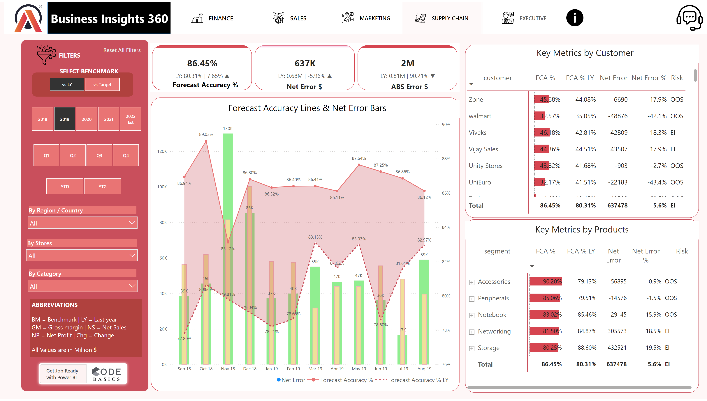
Supply Chain View
Notes:
shape
No alt text provided
image
No alt text provided
shape
No alt text provided
actionButton
No alt text provided
actionButton
No alt text provided
actionButton
No alt text provided
actionButton
No alt text provided
actionButton
No alt text provided
image
No alt text provided
image
No alt text provided
shape
No alt text provided
image
No alt text provided
textbox
No alt text provided
slicer
No alt text provided
textbox
No alt text provided
slicer
No alt text provided
slicer
No alt text provided
slicer
No alt text provided
slicer
No alt text provided
slicer
No alt text provided
slicer
No alt text provided
shape
No alt text provided
image
No alt text provided
shape
No alt text provided
textbox
No alt text provided
shape
No alt text provided
actionButton
No alt text provided
textbox
No alt text provided
shape
No alt text provided
image
No alt text provided
textbox
No alt text provided
textbox
No alt text provided
shape
No alt text provided
shape
No alt text provided
shape
No alt text provided
shape
No alt text provided
shape
No alt text provided
image
No alt text provided
shape
No alt text provided
textbox
No alt text provided
textbox
No alt text provided
scatterChart
No alt text provided
textbox
No alt text provided
image
No alt text provided
textbox
No alt text provided
pivotTable
No alt text provided
slicer
No alt text provided
cardVisual
No alt text provided
textbox
No alt text provided
textbox
No alt text provided
textbox
No alt text provided
shape
No alt text provided
lineClusteredColumnComboChart
No alt text provided
textbox
No alt text provided
shape
No alt text provided
shape
No alt text provided
pivotTable
No alt text provided
textbox
No alt text provided
pivotTable
No alt text provided
textbox
No alt text provided
actionButton
No alt text provided
textbox
No alt text provided
shape
No alt text provided
textbox
No alt text provided
shape
No alt text provided
shape
No alt text provided
shape
No alt text provided
actionButton
No alt text provided
shape
No alt text provided
shape
No alt text provided
shape
No alt text provided
shape
No alt text provided
shape
No alt text provided
textbox
No alt text provided
shape
No alt text provided
shape
No alt text provided

Slide 7
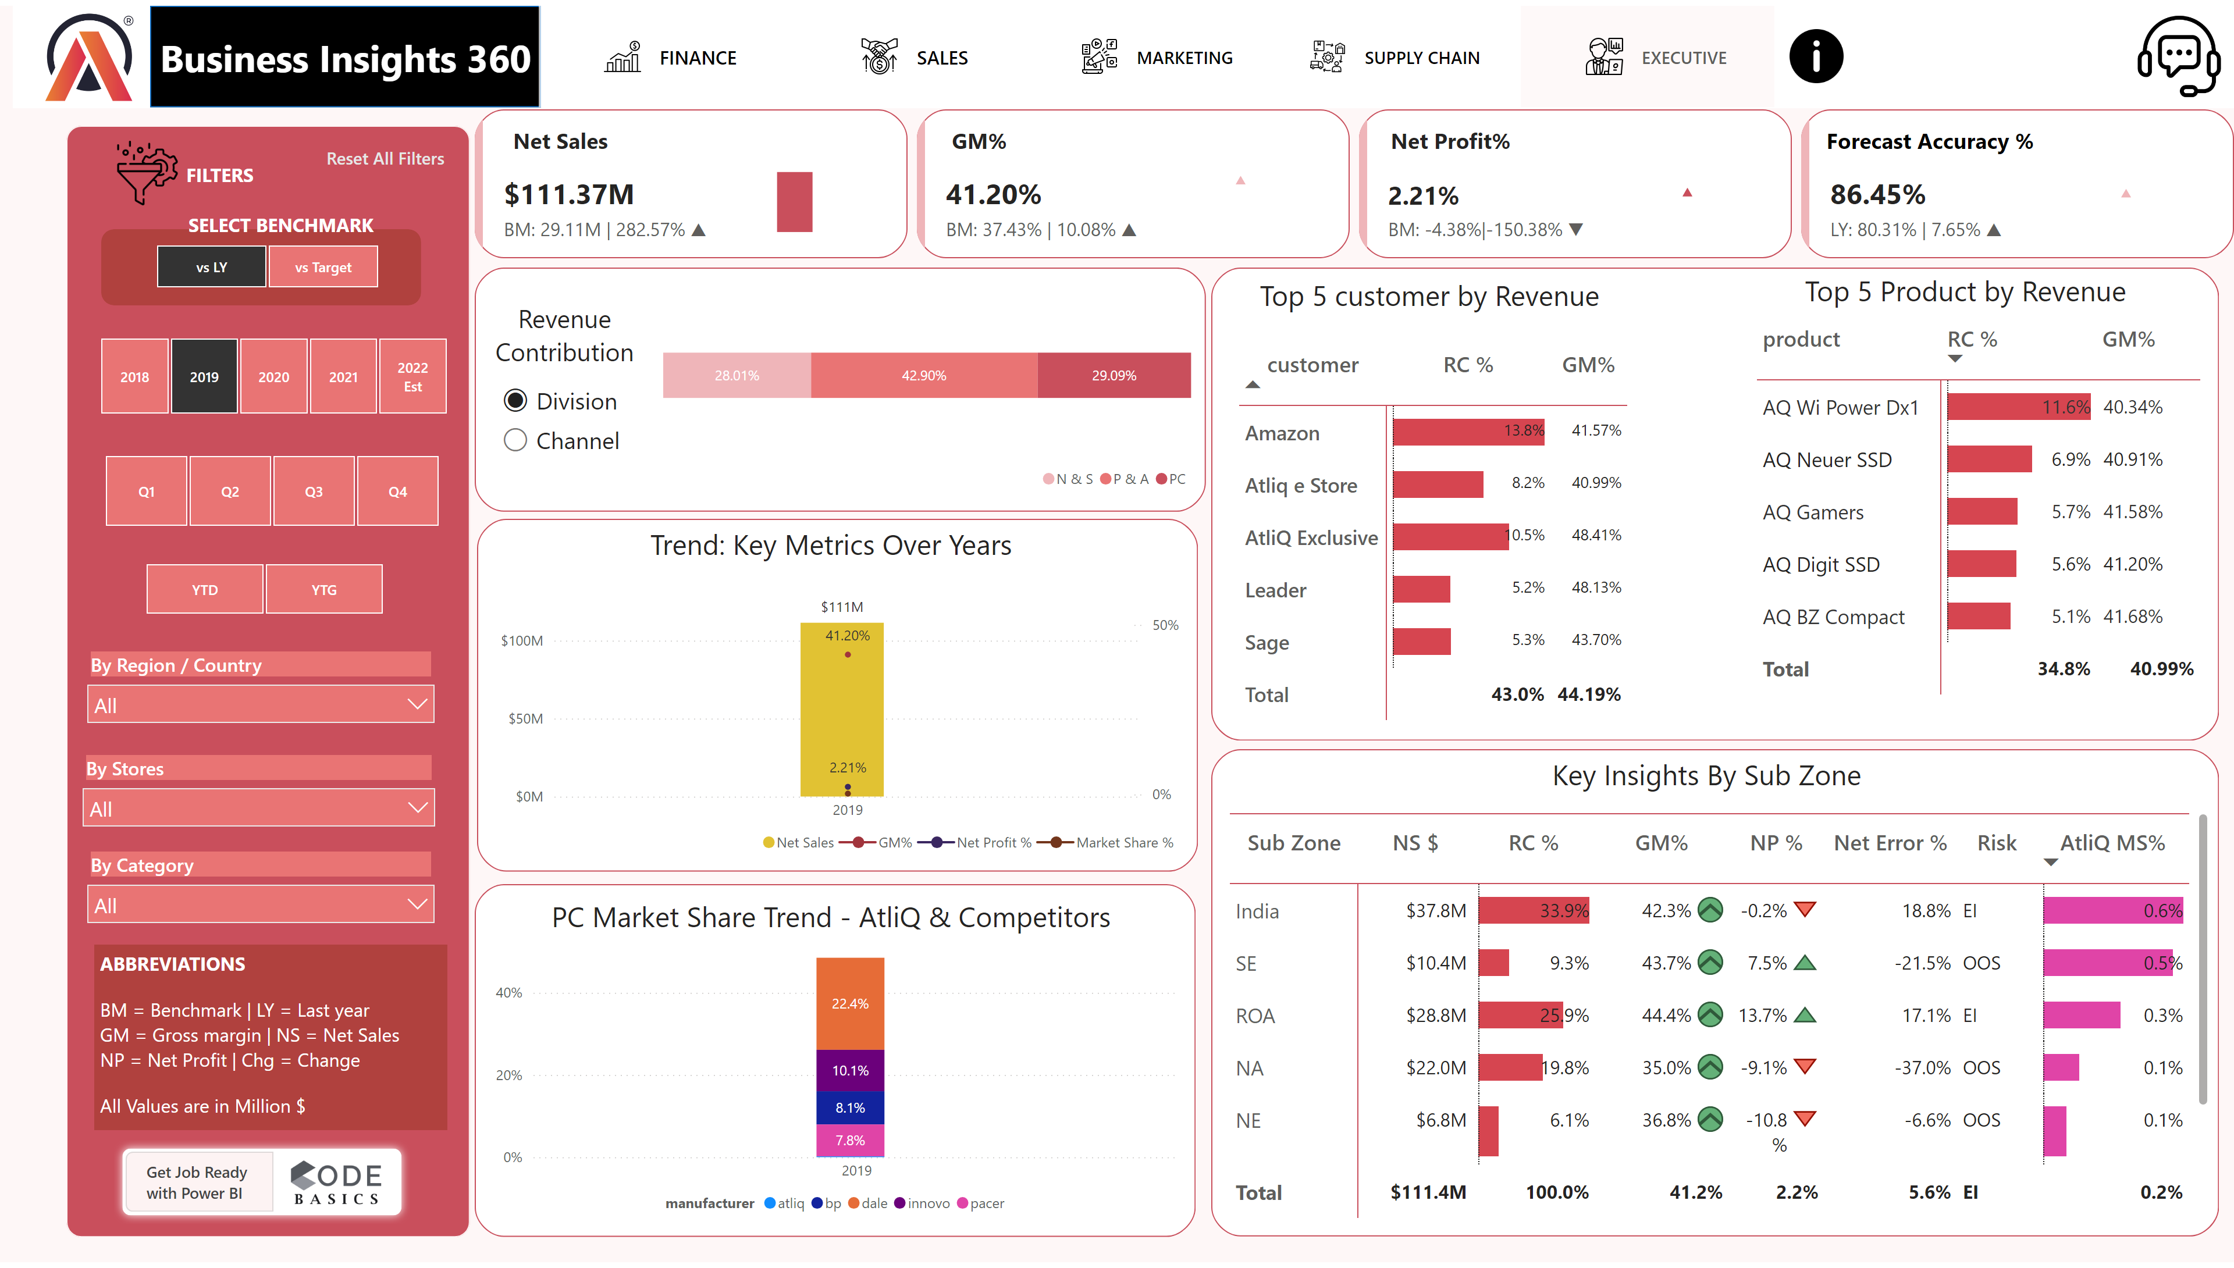
Executive View
Notes:
shape
No alt text provided
image
No alt text provided
shape
No alt text provided
actionButton
No alt text provided
actionButton
No alt text provided
actionButton
No alt text provided
actionButton
No alt text provided
actionButton
No alt text provided
image
No alt text provided
image
No alt text provided
shape
No alt text provided
image
No alt text provided
textbox
No alt text provided
slicer
No alt text provided
textbox
No alt text provided
slicer
No alt text provided
slicer
No alt text provided
slicer
No alt text provided
slicer
No alt text provided
slicer
No alt text provided
slicer
No alt text provided
shape
No alt text provided
image
No alt text provided
shape
No alt text provided
textbox
No alt text provided
shape
No alt text provided
actionButton
No alt text provided
textbox
No alt text provided
shape
No alt text provided
image
No alt text provided
textbox
No alt text provided
textbox
No alt text provided
shape
No alt text provided
shape
No alt text provided
shape
No alt text provided
shape
No alt text provided
shape
No alt text provided
image
No alt text provided
shape
No alt text provided
textbox
No alt text provided
textbox
No alt text provided
scatterChart
No alt text provided
textbox
No alt text provided
image
No alt text provided
textbox
No alt text provided
pivotTable
No alt text provided
slicer
No alt text provided
cardVisual
No alt text provided
textbox
No alt text provided
textbox
No alt text provided
textbox
No alt text provided
textbox
No alt text provided
clusteredColumnChart
No alt text provided
lineChart
No alt text provided
lineChart
No alt text provided
lineChart
No alt text provided
slicer
No alt text provided
textbox
No alt text provided
shape
No alt text provided
hundredPercentStackedBarChart
No alt text provided
shape
No alt text provided
pivotTable
No alt text provided
pivotTable
No alt text provided
textbox
No alt text provided
textbox
No alt text provided
shape
No alt text provided
shape
No alt text provided
lineClusteredColumnComboChart
No alt text provided
textbox
No alt text provided
textbox
No alt text provided
ribbonChart
No alt text provided
pivotTable
No alt text provided
shape
No alt text provided
textbox
No alt text provided
actionButton
No alt text provided
textbox
No alt text provided
shape
No alt text provided
textbox
No alt text provided
shape
No alt text provided
shape
No alt text provided
shape
No alt text provided
actionButton
No alt text provided
shape
No alt text provided
shape
No alt text provided
shape
No alt text provided
shape
No alt text provided
shape
No alt text provided
textbox
No alt text provided
shape
No alt text provided
shape
No alt text provided

